Slide 1



PhD Progress Meeting 2014
Development of Multimodal Quantitative MRI Techniques to Assess Brain Tissue Microstructure in Multiple Sclerosis
Mathieu Boudreau
December 18th 2014
Biomedical Engineering Dept.
McGill University
Committee:
Prof. Bruce Pike – Supervisor
Dr. Douglas Arnold - External member
Prof. Robert Funnell - Chair’s representative

Slide 2
Overview
Reminder of Hypotheses
Updated proposed manuscripts
List of Publications/Abstracts
Training & Collaborations
Progress
Publications/Abstracts
Manuscript 1 Progress
Manuscript 2 Progress
Manuscript 3 (Optional)
Manuscript 4 Progress
Upcoming Research Plan
Timeline
Notes:
BRIEF OVERVIEW OF Report

Slide 3
Previous Hypotheses
Whole-brain qMT maps can be acquired with a resolution of 1 mm³ in a clinically acceptable time of < 30 minutes.
High-resolution qMT WM/GM focal and diffuse pathology in post-mortem healthy and MS brains will correlate with immunohistochemistry measurements of pathology.
Is cortical GM MS pathology spatially independent of connectivity with WM lesions?
Notes:
3 HYPOTHESES FOR THIS PROECT ARE THE FOLLOWING

Slide 4
Previous Hypotheses
Whole-brain qMT maps can be acquired with a resolution of 1 mm³ in a clinically acceptable time of < 30 minutes.
B₁ Method Comparison for Whole-Brain T₁ Mapping (ISMRM 2014)
B₁-sensitivity of qMT (ISMRM 2014, ISMRM 2015)
High-resolution qMT WM/GM focal and diffuse pathology in post-mortem healthy and MS brains will correlate with immunohistochemistry measurements of pathology.
Is cortical GM MS pathology spatially independent of connectivity with WM lesions?
Notes:
3 HYPOTHESES FOR THIS PROECT ARE THE FOLLOWING

Slide 5
Previous Hypotheses
Whole-brain qMT maps can be acquired with a resolution of 1 mm³ in a clinically acceptable time of < 30 minutes.
B₁ Method Comparison for Whole-Brain T₁ Mapping (ISMRM 2014)
B₁-sensitivity of qMT (ISMRM 2014, ISMRM 2015)
High-resolution qMT WM/GM focal and diffuse pathology in post-mortem healthy and MS brains will correlate with immunohistochemistry measurements of pathology.
Is cortical GM MS pathology spatially independent of connectivity with WM lesions?
Notes:
3 HYPOTHESES FOR THIS PROECT ARE THE FOLLOWING

Slide 6
Revised Aims
Comparing quantitative transmit radiofrequency field (B₁) mapping methods for whole-brain variable flip angle T₁ maps
An analysis of the B₁-sensitivity of qMT parameters
Quantitative MT acquisitions can be optimized for both white and grey matter sensitivity over the whole brain with a resolution of 1 mm³ in a clinically acceptable time of <30 minutes.
Notes:
3 HYPOTHESES FOR THIS PROECT ARE THE FOLLOWING

Slide 7
List of Publications/Abstracts
Submitted Manuscripts
Nikola Stikov, Jennifer S.W. Campbell, Thomas Stroh, Stephen Frey, Jennifer Novek, Stephen Nuara, Ming-Kai Ho, Barry J. Bedell, Robert F. Dougherty, Ilana R. Leppert, Mathieu Boudreau, Sridar Narayanan, and G. Bruce Pike, “In vivo histology of the myelin g-ratio with magnetic resonance imaging”, Neuroimage, (Submitted on: December 5th 2014)
Published Manuscripts
Nikola Stikov, Mathieu Boudreau, Ives Levesque, Christine Tardif, Joëlle Barral, G. Bruce Pike, “On the Accuracy of T₁ Mapping: Searching for Common Ground”, Magnetic Resonance in Medicine, DOI: 10.1002/mrm.25135 (2014)
Manuscripts in Progress
Mathieu Boudreau, Christine Tardif, Nikola Stikov, G. Bruce Pike, “A Comparison of B₁ Mapping Methods for T₁ Mapping at 3T”, Proposed submission to: Magnetic Resonance in Medicine, Format: Technical Note (2015)
Mathieu Boudreau, Nikola Stikov, Douglas L. Arnold, G. Bruce Pike, “B₁-Sensitivity Analysis of qMT”, Proposed submission to: Magnetic Resonance in Medicine, Format: Full Paper (2015)
Proposed Manuscripts
Mathieu Boudreau, Nikola Stikov, Stephen Cauley, G. Bruce Pike, “Analytical Analysis of B₁-Sensitivity of Quantitative Magnetization Imaging”, Proposed submission to: Medical Physics, Format: Technical Note (2015)
Mathieu Boudreau, Ives R. Levesque, David Rudko, Tao Zhang, Douglas L. Arnold, G. Bruce Pike, “Optimized Acceleration of Quantitative Magnetization Transfer Parameter Mapping Using Locally Low Rank Sparsity”, Proposed submission to: Magnetic Resonance in Medicine, Format: Full Paper (2015)

Slide 8
List of Publications/Abstracts
Peer Reviewed Conference Abstracts
N. Stikov, J. Campbell, M. Boudreau, S. Narayanan, T. Stroh, S. Nuara, J. Novek, S. Frey, M.-K. Ho, B. Bedell, G. B. Pike, “In vivo histology of the myelin g-ratio”, Poster, OHBM Annual Meeting (2014)
Mathieu Boudreau, Nikola Stikov, G. Bruce Pike, “A B₁ Insensitive qMT Protocol”, Poster, International Society for Magnetic Resonance in Medicine Meeting (2014)
Mathieu Boudreau, Christine Tardif, Nikola Stikov, G. Bruce Pike, “A Comparison of B₁ Mapping Methods for T₁ Mapping at 3T”, E-Poster, International Society for Magnetic Resonance in Medicine Meeting (2014)
Mathieu Boudreau, Nikola Stikov, G. Bruce Pike, “Effect of Different T₁ Mapping Techniques on a Quantitative Magnetization Transfer MRI Biomarker for Myelin Density”, Poster, endMS Conference (2013)
Mathieu Boudreau, Nikola Stikov, G. Bruce Pike, “T₁ Mapping: Should We Agree To Disagree?”, Poster, International Society for Magnetic Resonance in Medicine Meeting (2013)
Submitted Conference Abstracts
Mathieu Boudreau, Nikola Stikov, G. Bruce Pike, “B₁-Sensitivity Analysis of qMT”, Submitted to: International Society for Magnetic Resonance in Medicine Meeting 2015
Ye Gu, Mathieu Boudreau, Ives R Levesque, Yaaseen Atchia, John Sled, Sridar Narayanan, Douglas L. Arnold, Bruce Pike, and Nikola Stikov, “Quantitative Magnetization Transfer Analysis: An Interactive Introduction with qMTLab”, Submitted to: International Society for Magnetic Resonance in Medicine Meeting 2015

Slide 9
2014 Training
2013 endMS conference (Saint-Sauveur)
scholarship covering the complete cost of attending the conference.
communication workshop by the Alan Alda Center for Communicating Science).
Presented work
1 traditional poster
2014 ISMRM meeting (Milan)
ISMRM Trainee Educational Stipend
Educational Weekend
Presented work
1 traditional poster
1 electronic poster.
endMS Network workshops (Montreal)
endMS Statistics Series.
Software Carpentry workshop (Montreal)
2014 MS Exchange Conference (Montreal).

Slide 10
2014 Collaborations
Dr. Nikola Stikov and Dr. Jennifer Campbell (MNI)
g-ratio project – acquisition/analysis of qMT in MS patient and macaque monkey.
co-authorship in a recently submitted manuscript (Appendix D).
Dr. Julien Cohen-Adad (Polytechnique Montreal) and Dr. Stikov
Over several months, I was involved with planning, acquiring, and analyzing qMT data in pig and cat spinal cords on our human 3T MRI at the MNI, and the animal 7T scanner at the Montreal Heart Institute.
Dr. Jacqueline Chen (Lerner Research Institute, Cleveland, Ohio)
Implementation of an AFI B₁ mapping acquisition and analysis on their scanner.
Dr. Aviv Mezer (Stanford University)
Exploring the feasibility of improved fitting the MT exchange rate kf by fixing F in the model using his macromolecular tissue volume biomarker for myelin.
Dr. David Rudko and Dr. Robert Brown (MNI)
Assistance with acquiring and analyzing qMT data using our qMT software.
Melany Ann McLean (University of Calgary, Dr. Pike’s lab)
Assistance with qMT data analysis development for a small animal project.

Slide 11
Progress – Manuscript 1 Section 4.1: Quantitative Comparison of B₁ Mapping Methods for White Matter T₁ Mapping at 3T (90% complete)
Background
Several highly cited novel B₁ methods have recently been developed for whole-brain imaging
We intend to show that k-space accelerated (in our case EPI) DA is a valid alternative to these methods, and that all methods produce T₁ maps in good agreement with each other
An important advantage to this method is that it uses stock scanner sequences, no pulse sequence programming required.
Aim: Compare VFA T₁ maps in WM produced with four B₁ methods (ISMRM2014):
Conventional double angle (Ref. DA),
Bloch-Siegert (BS)
Actual Flip-Angle Imaging (AFI)
DA spin-echo EPI (EPI-DA).
Proposed manuscript format: Technical report, MRM

Slide 12
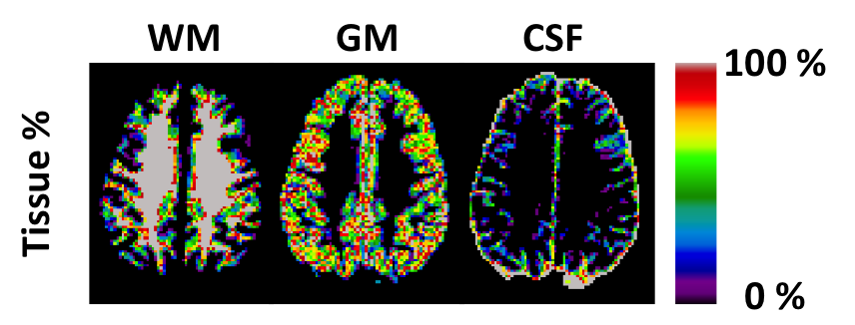
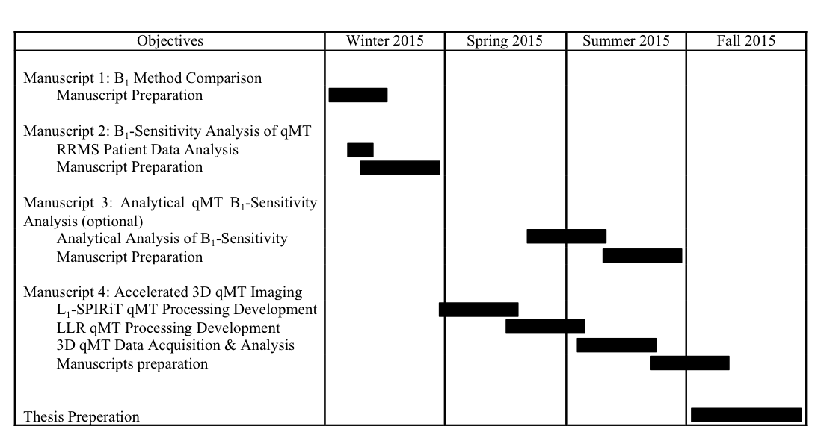
Section 4.1: Quantitative Comparison of B₁ Mapping Methods for White Matter T₁ Mapping at 3T (90% complete)
Tissue classification maps (2x2x5 mm³, black = 0%, grey = 100%) of a typical healthy subject predicted from INSECT using MPRAGE T1w data (1x1x1 mm³), and resampled using a majority voting analysis.

Slide 13
Section 4.1: Quantitative Comparison of B₁ Mapping Methods for White Matter T₁ Mapping at 3T (90% complete)
Figure 1. Normalized pooled histograms of single slice WM T₁ values for 6 healthy subjects (bin width = 10 ms).

Slide 14
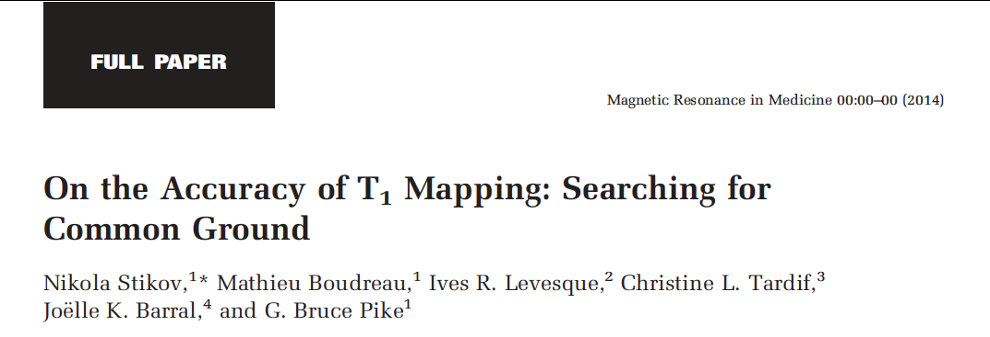
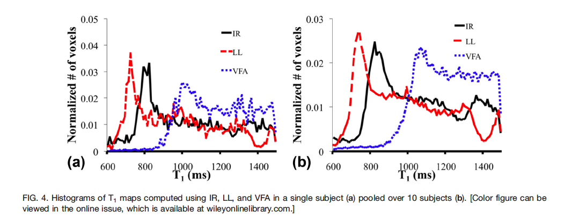

Slide 15
Section 4.1: Quantitative Comparison of B₁ Mapping Methods for White Matter T₁ Mapping at 3T (90% complete)
 | Ref. DA | BS | AFI | EPI-DA
Pearson ρ | ----------- | 0.97 | 0.97 | 0.99
Fit slope | ----------- | 0.98 | 1.00 | 0.97
Figure 5: Table listing the linear regression analysis of the pooled WM T₁ values (6 subjects) for each B₁ method relative to the reference DA B₁ method.

Slide 16
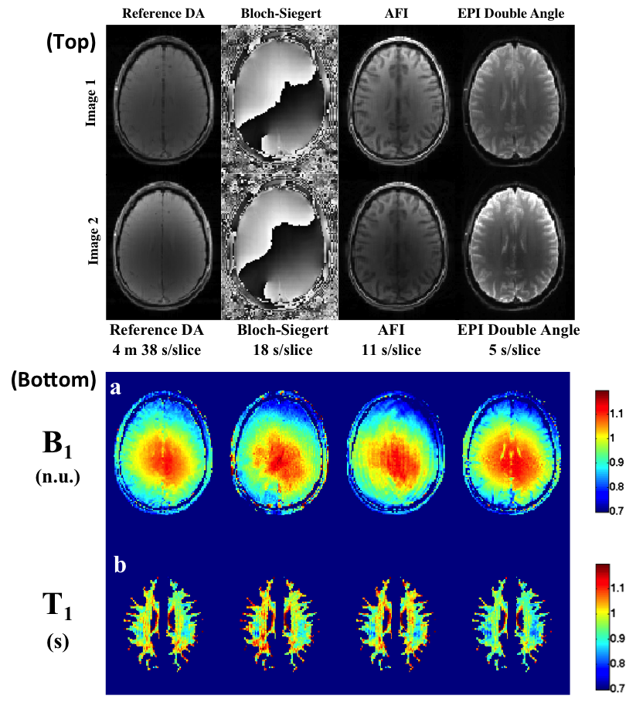
Section 4.1: Quantitative Comparison of B₁ Mapping Methods for White Matter T₁ Mapping at 3T (90% complete)
Figure 2. (Top) Raw B₁ acquisition images for each method. (Bottom) (a) Single slice B₁ maps from a representative subject. (b) WM VFA T₁ maps using flip angles corrected with each B₁ map.

Slide 17
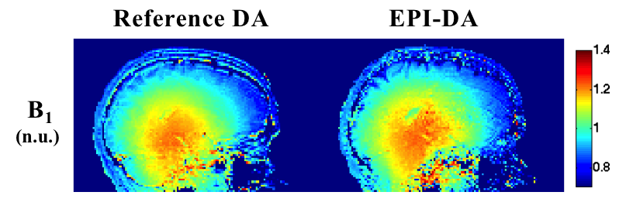
Section 4.1: Quantitative Comparison of B₁ Mapping Methods for White Matter T₁ Mapping at 3T (90% complete)
Figure 3. Sagittal (left hemisphere) B₁ maps for a single subject using the reference and EPI double angle methods.

Slide 18
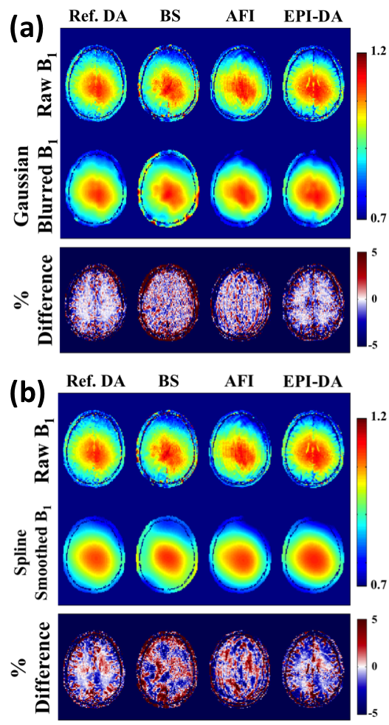
Section 4.1: Quantitative Comparison of B₁ Mapping Methods for White Matter T₁ Mapping at 3T (90% complete)
Figure 4. Comparison between raw B₁ maps and filtered maps using: (a) Gaussian blurring (b) spline smoothing.

Slide 19
Progress – Manuscript 2 Section 4.2: B₁-Sensitivity Analysis of qMT (80% complete)
qMT imaging – requires additional qMRI measurements (B₀, B₁,T₁)
These are typically independent of each other
but certain T₁ mapping techniques also require B₁ maps (e.g. variable flip angle – VFA).
For VFA T₁, B₁ is used twice before fitting the qMT parameters
to correct the flip angles for T₁ mapping
to scale the nominal MT saturation powers and excitation FA.
Inaccuracies in B₁ would propagate to the fitting of the qMT parameters through two pathways
errors induced in T₁
errors in MT saturation powers and excitation FA
This work demonstrated that for the Sled and Pike SPGR qMT model, the pool-size ratio F much less sensitive B₁ inaccuracies when using VFA for T₁ mapping.
Proposed manuscript format: Full Paper, MRM

Slide 20
Progress – Manuscript 2 Section 4.2: B₁-Sensitivity Analysis of qMT (80% complete)
Separated into 5 parts
Noiseless simulation of single tissue qMT for B₁/T₁ inaccuracies (ISMRM 2015)
B₁-sensitivity of qMT parameters in-vivo (ISMRM 2014)
Comparison using 3 B₁ mapping methods
B₁-sensitivity of qMT parameters in pathology: RRMS patient
Insights on the origin of the qMT F B₁-insensitivity

Slide 21
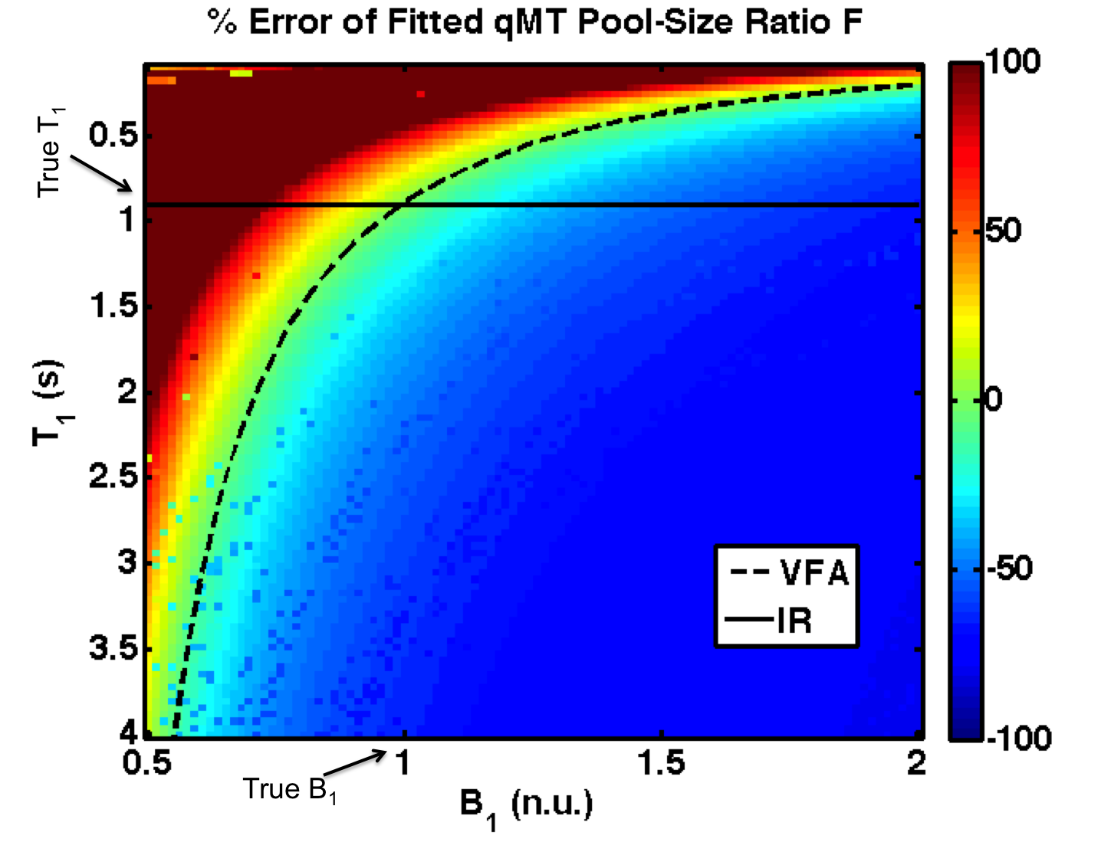
Section 4.2 – Part 1: Noiseless simulation of single tissue qMT for B₁/T₁ inaccuracies
Figure 6: Percent error in fitted qMT F values in the presence of a wide range of B₁ and T₁ errors (B_{1,true} = 1 n.u., T_{1,true} = 0.9 s). The superimposed lines plot the T₁ distribution for a B₁-independent T₁ mapping method (IR, solid line) and VFA (dashed line).

Slide 22
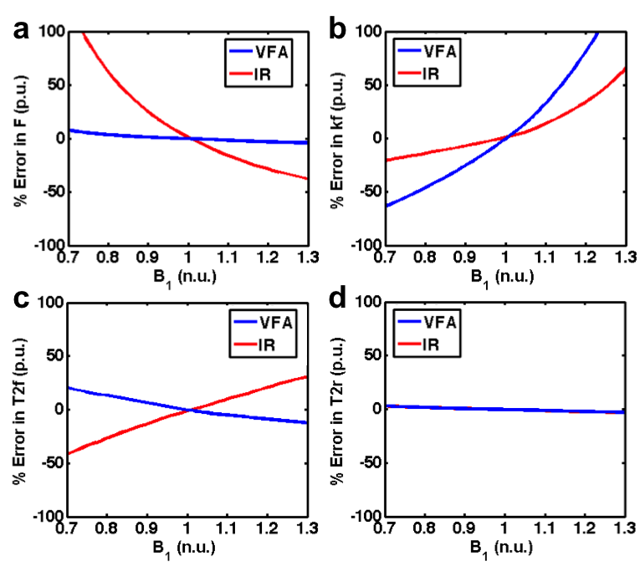
Section 4.2 – Part 1: Noiseless simulation of single tissue qMT for B₁/T₁ inaccuracies
Figure 7: Percent error in fitted qMT parameters for a range of B₁ errors (a – pool size ratio (F), b – magnetization exchange rate (kf), c – free pool T2 (T2f), d – restricted pool T2 (T2r)). Fits using a B₁-independent T₁ measure (IR) are shown in red, and those using VFA T₁ mapping are shown in blue. See solid and dashed lines in Fig. 2 for B₁ dependence of IR and VFA T₁.

Slide 23
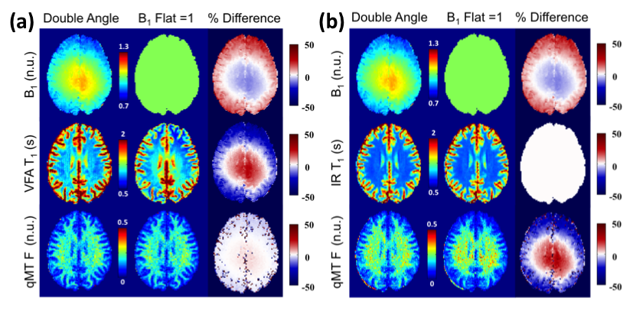
Section 4.2 – Part 2: B₁-sensitivity of qMT parameters in-vivo
Figure 8: A single subject comparison of qMT F maps fitted using DA and flat (B₁ = 1) B₁ maps using (a) VFA T₁ maps corrected using the corresponding B₁ map and (b) IR T₁ maps independent of B₁.

Slide 24
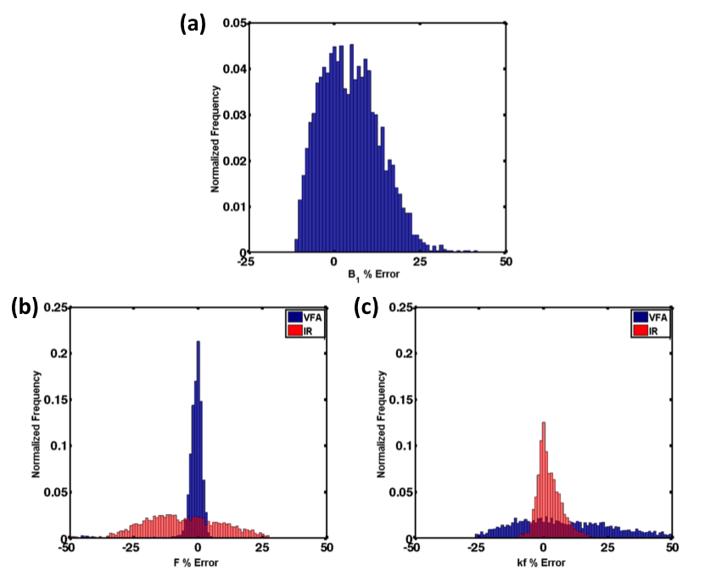
Section 4.2 – Part 2: B₁-sensitivity of qMT parameters in-vivo
Figure 9: a – Histogram of B₁ error in the nominal B₁ (Flat B₁ = 1) assumption relative to the DA B₁ map in a single subject. b – Histogram of fitted qMT F error % between nominal and DA B₁ map, when using IR (red) or VFA (blue) T₁ mapping. c – Histogram of fitted qMT kf error % between nominal and DA B₁ map, when using IR (red) or VFA (blue) T₁ mapping.

Slide 25
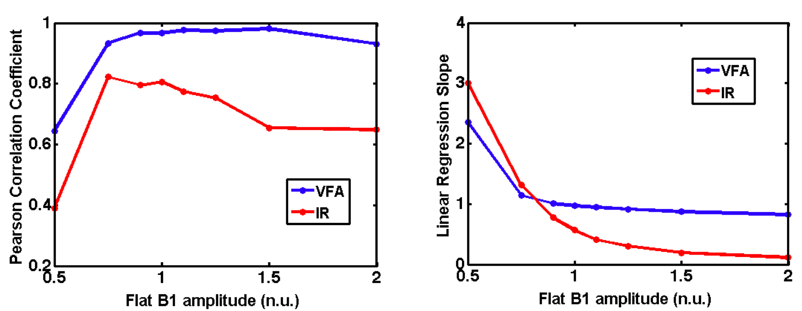
Section 4.2 – Part 2: B₁-sensitivity of qMT parameters in-vivo
(a)
(b)
Figure 10: Pooled (all subjects) whole brain Pearson correlation coefficients (a) and linear regression slopes (b) for qMT F values between the measured DA B₁ maps and simulated flat B₁ maps.

Slide 26
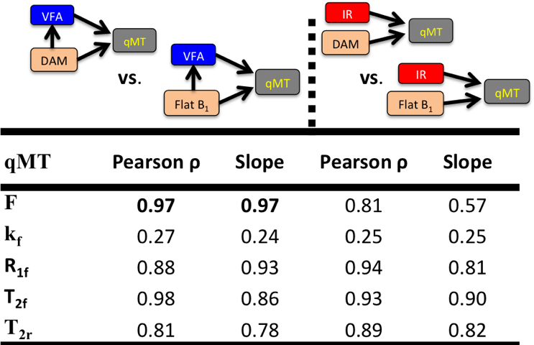
Section 4.2 – Part 2: B₁-sensitivity of qMT parameters in-vivo
Figure 11: Pooled (all subjects) whole brain Pearson correlation coefficients and linear regression slopes for qMT F values between the measured DA B₁ maps and simulated flat B₁ maps.

Slide 27
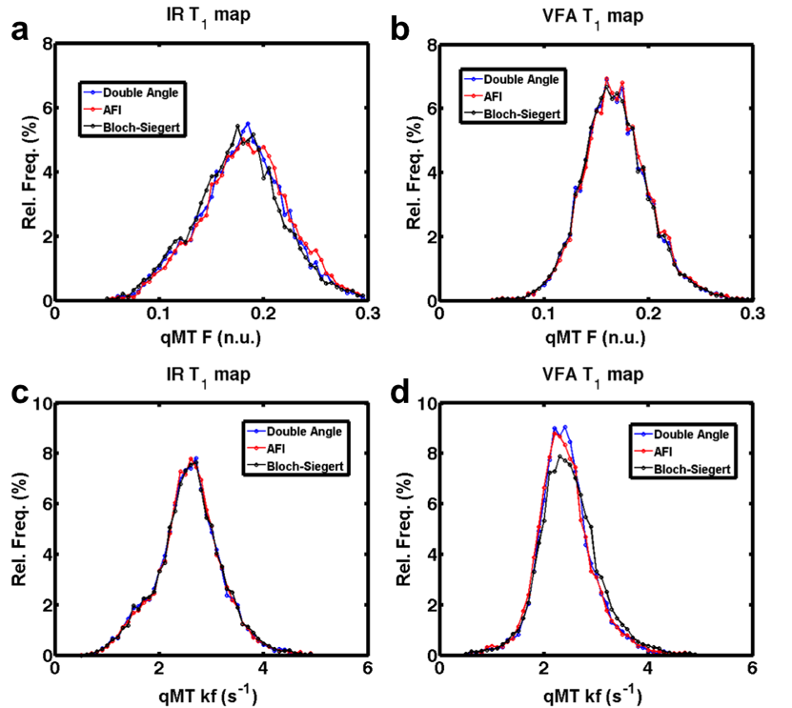
Section 4.2 – Part 3: Comparison using 3 B₁ mapping methods
Figure 12: Single-subject WM pool-size ratio (a, b) and exchange coefficient (c, d) distributions for 3 B₁ mapping methods, using IR T₁ mapping (a, c) and VFA T₁ mapping (b, d).

Slide 28
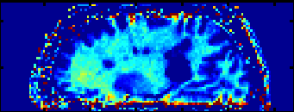
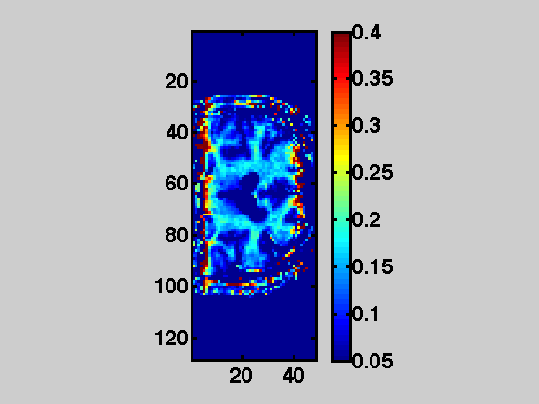
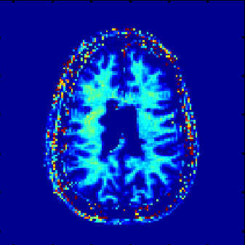
Section 4.2 – Part 4: B₁-sensitivity of qMT parameters in pathology: RRMS patient
qMT F Maps

Slide 29
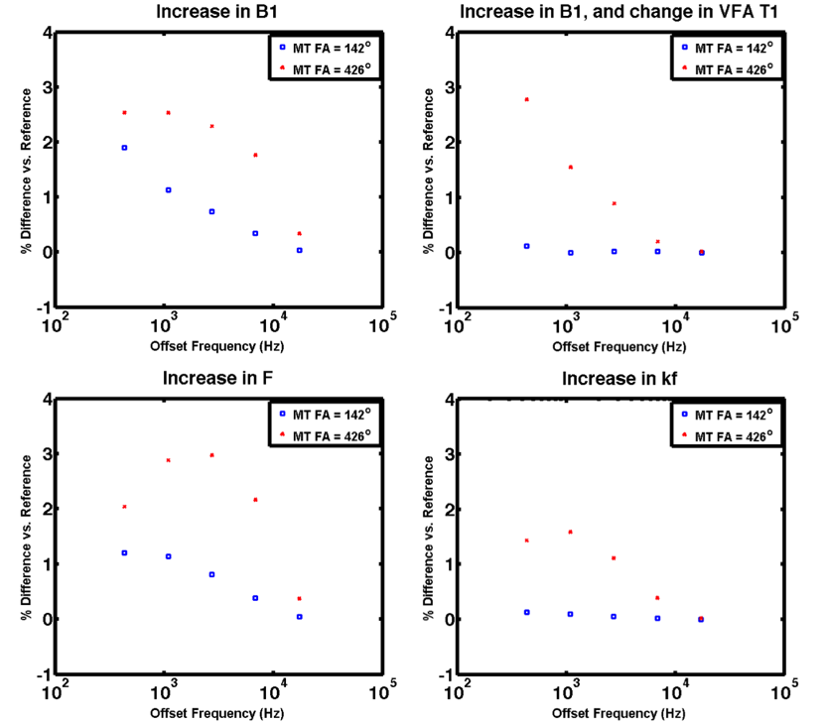
Section 4.2 – Part 5: Insights on the origin of the qMT F B₁-insensitivity
Figure 13: Sensitivity analysis of the MT signal for changes in tissue or fitting variables: a – 5 % increase in B₁ relative to the true B₁, T₁ independent of B₁ b – 5 % increase in B₁ relative to the true B₁, T₁ dependent of B₁ (VFA) c – 10% increase in the pool-size ratio F d – 10% increase in the MT exchange coefficient kf.

Slide 30

Progress – Manuscript 3 (optional) Section 4.3: Analytical qMT Sensitivity Analysis
Approximated from Taylor expansion
Defining the sensitivity parameter
Equation for complete measurement set (N = # qMT points)
S
ψ
Ψ
Solving for the parameter changes column vector (small phi)
Proposed manuscript format: Technical Note or Full Paper, Medical Physics

Slide 31
Progress – Manuscript 4 Section 4.4: qMT Compressed Sensing (20% complete)
Developed sparse k-space 2D GRE sequence (base sequence for our qMT sequences)
Single point qMT sequence, UI MT parameter control (MT saturation, off-resonance frequency).
Siemens raw data Matlab code
An open source 3D L₁-SPIRIT multi-channel sparse acquisition image reconstruction software package was tested on preliminary data.
Raw k-space data acquired
5 healthy subjects
Two sets of qMT protocols: UK (uniform) and Optimized.
Proposed manuscript format: Full Paper, MRM

Slide 32
Upcoming Research Plan Completing Manuscripts 1 & 2 January 2015- March 2015
Finish writing manuscript #1
Analyze MS data for manuscript #2
Write manuscript #2

Slide 33
Upcoming Research Plan Sections 5.1 & 6.1: qMT Compressed Sensing March 2015 - September 2015
qMT point by point sensitivity to CS-reconstruction
L₁-Spirit+Wavelet reconstruction
Using single slice, 2x2x5 mm³ qMT data (5 healthy subjects)
Compare with locally low rank sparsity reconstruction
Try on-hand data first
May need to acquire more data
LLR sensitive to in-scan motion
Acquire small set of whole brain hi-res qMT
Compare qMT-point optimized L₁-Spirit with LLR

Slide 34
Upcoming Research Plan Sections 5.1 & 6.1: qMT Compressed Sensing March 2015 - September 2015
Optimize qMT sequence for 3D measurement
Aim for 15 ms TR
Pulse Sequence Mods. | Hard Limits | List of Consequences to Seq. Mods.
Shorten MT spoiler gradient | Max . gradient strength | /w MT pulse shortening, may have induced diffusion weighted spin echo at readout (shorter diff time). Risks affecting highest MT/smallest offres freq.
 | Slew rate | Eddie currents
Shorten MT pulse | Peak B1 | Strong enough MT signal saturation from high MT FA may not be achievable
 | SAR
Increase readout bandwith | Max . gradient strength | SNR decrease
 | Slew rate
Shorten TR | TE ( & bandwidth) | SAR increase
 | MT Pulse Duration | SNR decrease
 | MT Spoiler Duration
Shorten TE | Readout bandwidth | Small SNR increase, but overshadowed by bandwidth change

Slide 35
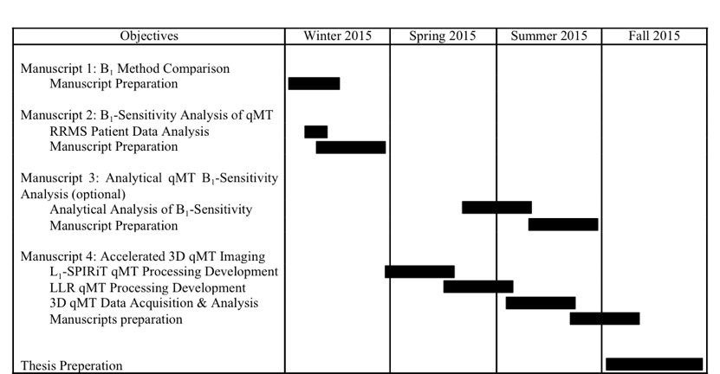
Thesis Completion Timeline

Slide 37
PhD Progress Meeting 2014
Development of Multimodal Quantitative MRI Techniques to Assess Brain Tissue Microstructure in Multiple Sclerosis
Mathieu Boudreau
December 18th 2014
Biomedical Engineering Dept.
McGill University
Committee:
Prof. Bruce Pike – Supervisor
Dr. Douglas Arnold - External member
Prof. Robert Funnell - Chair’s representative

